Slide 1
Warm-Up
DO NOT LOG IN
DO NOT GET YOUR KITS
We are changing partners

Slide 2
Announcements
Grading will be different

Slide 3
Warm-Up
What is wrong with this code?
#define LED1 13
pinMode(LED1, OUTPUT);
if(digitalRead(LED1 == HIGH)
digitalWrite(LED1, LOW);

Slide 4
Warm-Up
What is wrong with this code?
#define LED1 13
pinMode(LED1, OUTPUT);
if(digitalRead(LED1 == HIGH) (digitalRead only works for inputs)
digitalWrite(LED1, LOW);

Slide 5
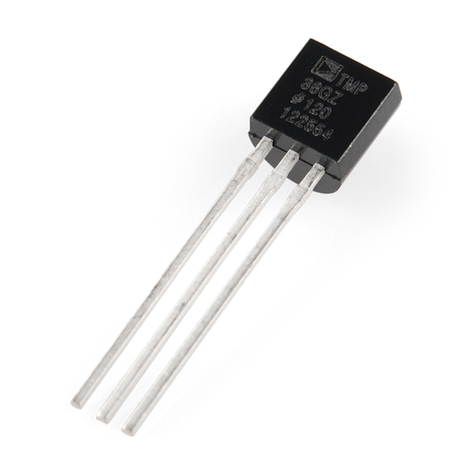
Temperature
Measure using a thermistor, a sensor that changes resistance in response to temperature
High temp = low resistance
TMP36 temperature sensor
Analog or digital?
Input or output?

Slide 6
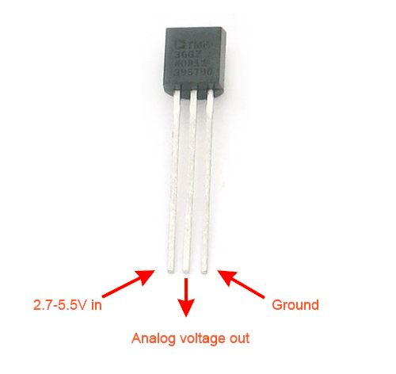

Slide 7
Analog Input
Temperature is an analog input
Convert the reading from the sensor into an actual temperature value
Conversion:
Voltage = ((sensor*5000)/1024) – 500
Celsius = Voltage / 10
Fahrenheit = Celsius*1.8 + 32

Slide 8
Project #8
Build a temperature sensing circuit
Use red, green, and blue LEDs to indicate hot, mild, and cold temperatures

Slide 9
Warm-up
How many different circuits do you need to wire for this project?
How many output and input?

Slide 10
Warm-up
How many different circuits do you need to wire for this project?
4
How many output and input?
3 Output
1 Input (which does not need to be declared)

Slide 11
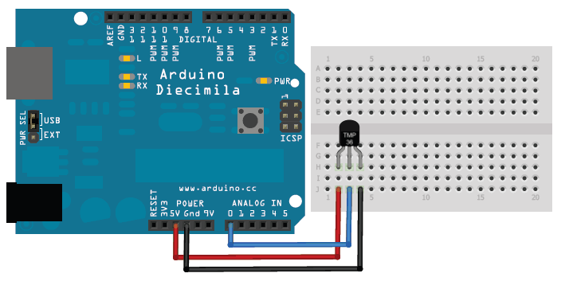
Correction

Slide 12
Communicating
Serial.begin(9600);
Sets the speed at 9600 BPS for communication between the Arduino and the computer
Do this in void setup( )

Slide 13
Reading Analog Signals
analogRead(Pin#);

Slide 14
Printing Your Results
Serial.print( );
Serial.println( );

Slide 15
Programming Algorithm
Read the value from the sensor
Convert the sensor reading to a temperature in Fahrenheit
Voltage = (sensor*5000)/1024
Voltage = Voltage – 500;
Celsius = Voltage / 10
Fahrenheit = Celsius*1.8 + 32
Use floats for your calculations
If the temp > 80, turn on a red LED
If 60 < temp < 80, turn on a green LED
If temp < 60, turn on a blue LED

