Slide 1
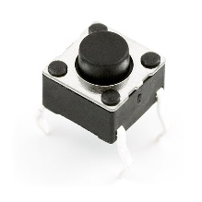
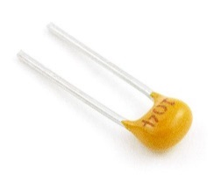
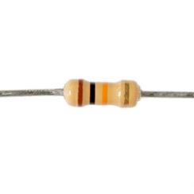
Warm-up
What is the difference between input and output?
What would an if statement be used with (input or output)?
If you are finished with your RGB LED Lab place it back in the LED box at the front of the class.
You will also need to pick up ONE push button and ONE capacitor and ONE 10k Ohm Resistor per team. Put them in your kit.

Slide 2
Four Year Plan
Sign it

Slide 3
Warm-up
What is the difference between input and output?
Input senses information given to the circuit, output gives information/voltage
What would an if statement be used with (input or output)?

Slide 4
Warm-up
What is the difference between input and output?
Input senses information given to the circuit, output gives information/voltage
What would an if statement be used with (input or output)?
Input

Slide 5
Today…
Inputs and outputs
Switches
Capacitors
Project #4 - Circuit

Slide 6
Inputs and Outputs
Output → information goes OUT of the Arduino and into the system
Activating something in the circuit
LEDs, buzzers, displays
Input → information goes INTO the Arduino from the system
Gives the Arduino information about the system
Used to make decisions
Switches, sensors, microphone, buttons

Slide 7
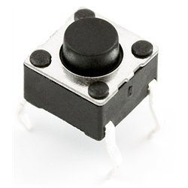
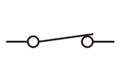
Switches
INPUT DEVICE
Two states, OPEN or CLOSED
OPEN switch
Current cannot flow
Broken wire
“OFF” state
CLOSED switch
Current is able to flow
“ON” state

Slide 8
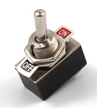
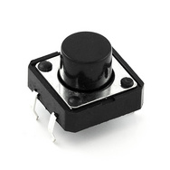
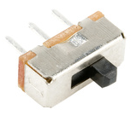
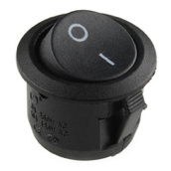
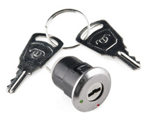
Common Switches
TOGGLE
PUSH BUTTON
SLIDE
ROCKER
KEY

Slide 9
Push Button
Default position is “open”
Circuit is “off”
Press down, position is “closed”
Circuit is “on”

Slide 10
Using Your Push Button

Slide 11
Using Your Push Button
SIDE 1
SIDE 2

Slide 12
Using Your Push Button
SIDE 1
SIDE 2

Slide 13
Using Your Push Button
SIDE 1
SIDE 2

Slide 14
Using Your Push Button
SIDE 1
SIDE 2

Slide 15
Using Your Push Button
SIDE 1
SIDE 2

Slide 16
Using Your Push Button
SIDE 1
SIDE 2

Slide 17
Capacitor
Electronic component that holds electrical charge
Kind of like a battery
Consists of two metal plates that trap electrons between them, discharging them after it becomes “full”
Capacitance → measure of how much charge a capacitor can store before discharging
Measure in farads (F)
One farad is HUGE, so most capacitors will come in nF or μF

Slide 18
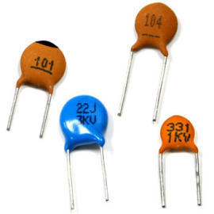
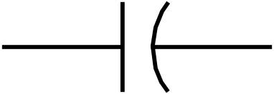
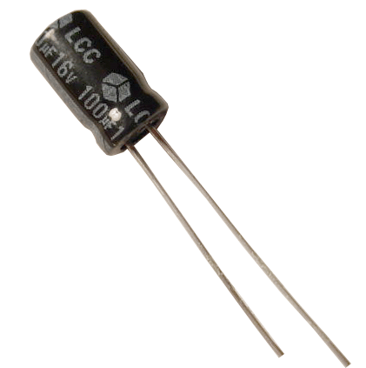
Types of Capacitors
Ceramic
Small amounts of charge
Charge and discharge quickly
Not polarized
High frequency circuits
Electrolytic (Aluminum)
Can hold large charges
Polarized (have a pos (+) and neg (-) side)
Noise filters

Slide 19
Project #4
Design a circuit with a switch, an LED, and a capacitor
Write a program that will turn on the LED for half a second whenever the button is pressed
Working on this circuit today and tomorrow

Slide 20
Tomorrow: The Algorithm
Check to see if the button has been pressed.
If the button has been pressed, turn on the LED for half a second, then turn if off.
If the button has not been pressed, do nothing.
Repeat indefinitely.

Slide 21
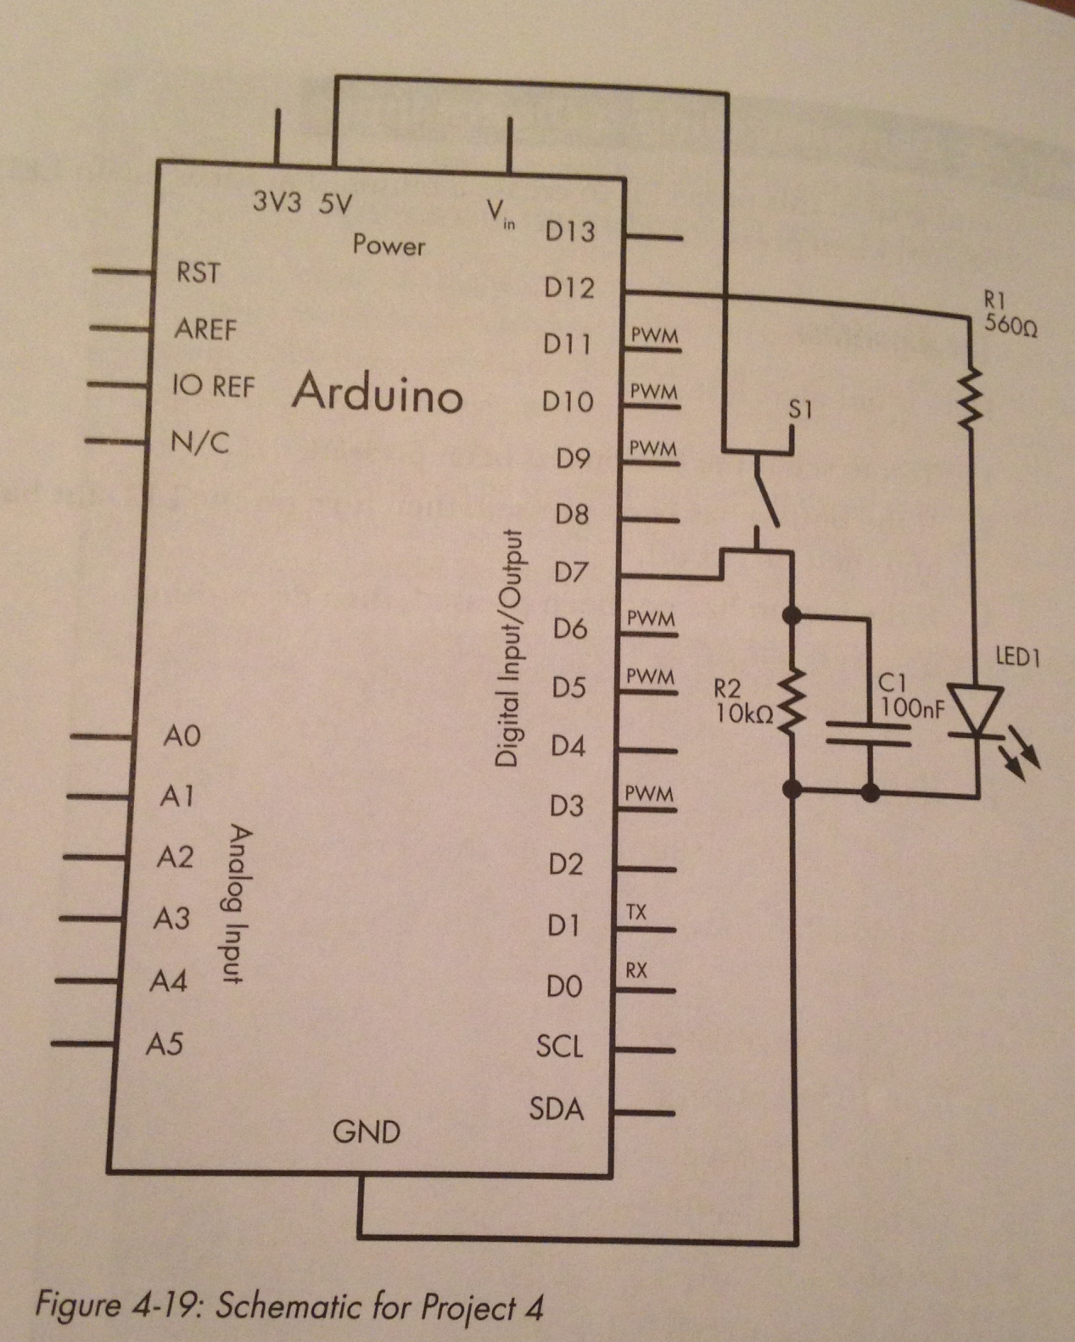
Materials:
560-Ohm resistor
LED (any color)
100nF capacitor
10 K-Ohm resistor
Push-button switch
Arduino
USB cable
Jumper wire
Breadboard
DO NOT PLUG IN YOUR ARDUINO UNTIL I’VE CHECKED YOUR CIRCUIT

Slide 22
Warm-up
How are switches and if conditions related?

Slide 23
Overview
Conditional Statements
Comparators
Booleans
Project #4 - Programming

Slide 24
Conditional Statements
Check to see IF something is true or false
Execute different lines of code based on the answer
IF this is true, do this
IF this is not true, do something else
Based on either COMPARISON or BOOLEAN Logic

Slide 25
Syntax – IF Statements
if (condition)
{
statements;
}
else
{
statements;
}
***Additional conditions can be included with the “else if” statement
if (condition) { }
else if (condition) { }
else { }

Slide 26
Types of Comparators
Less than (<)
Greater than (>)
Less than or equal to (<=)
Greater than or equal to (>=)
Equal to (==)
Not equal to (!=)
Logic statement returns a TRUE or a FALSE

Slide 27
Examples
x = 5 y = 4 z = 7
x > y → true
z == y → false
x + z > 11 → true
x + y != z + 2 → false

Slide 28
Booleans
Exists in one of two states
TRUE or FALSE
HIGH or LOW
1 or 0
Used often with microcontrollers
If this pin is HIGH, do this
If this pin is LOW, do this

Slide 29
digitalRead( )
Function used to read a digital input pin as HIGH or LOW
Syntax:
digitalRead(pin#);
Return:
HIGH or LOW

Slide 30
Example – IF Statements
void setup( ) {
pinMode(3, OUTPUT);
pinMode(4, INPUT);
}
void loop( ) {
if (digitalRead(4) == HIGH) {
digitalWrite(3, HIGH);
} else {
digitalWrite(3, LOW);
}
}

Slide 31
#define
#define RedLED 13
#define BlueLED 12
Place this above void setup () to declare your variables

Slide 32
Algorithm:
Check to see if the button has been pressed.
If the button has been pressed, turn on the LED for half a second, then turn if off.
If the button has not been pressed, do nothing.
Repeat indefinitely.

Slide 33
Algorithm:
Check to see if the button has been pressed.
If the button has been pressed, turn on the LED for half a second, then turn if off.
If the button has not been pressed, do nothing.
Repeat indefinitely.

Slide 35
Advanced Assignment
Adjust the length of time the light stays on when you press the button (+1 pt)
Adjust the program so that the light stays on as long as the button is held down (+1 pt)
Add an additional LED to your circuit, so that 2 LEDs turn on when you press the button. (+3 pts)

