Slide 1
Warm-Up
What is 9 in binary?
What is 110 as a decimal number?

Slide 2
Warm-Up
What is 9 in binary?
9 = 8 + 1 = 2³ + 2⁰ → 1001
What is 110 as a decimal number?
110 = 2² + 2¹ = 4 + 2 → 6

Slide 3
Limitation of Arduino Pins
Arduino board has 14 digital pins that we can use as output or input
Pins 0-13
As you can guess, sometimes 14 pins just isn’t really enough

Slide 4
Shift Registers
Used to add more outputs
What is it?
An integrated circuit (IC) with 8 digital output pins that can be controlled by sending a byte of data to the IC

Slide 5
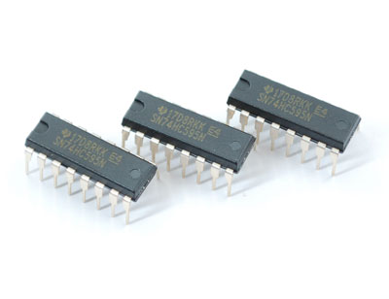

Slide 6
About the 74HC595 Shift Register
8 digital outputs that operate exactly like the Arduino digital outputs
Takes up 3 digital outputs on the Arduino to control the 8 digital outputs it contains
NET GAIN = 5 DIGITAL OUTPUT PINS

Slide 7
Controlling Pins with the Shift Register
Send the shift register a single byte of data
EX: B10000110
Each 1 or 0 turns one of the shift register’s outputs on or off
Pins are counted right to left, beginning with 0
This example turns pins 7, 2, and 1 on

Slide 8
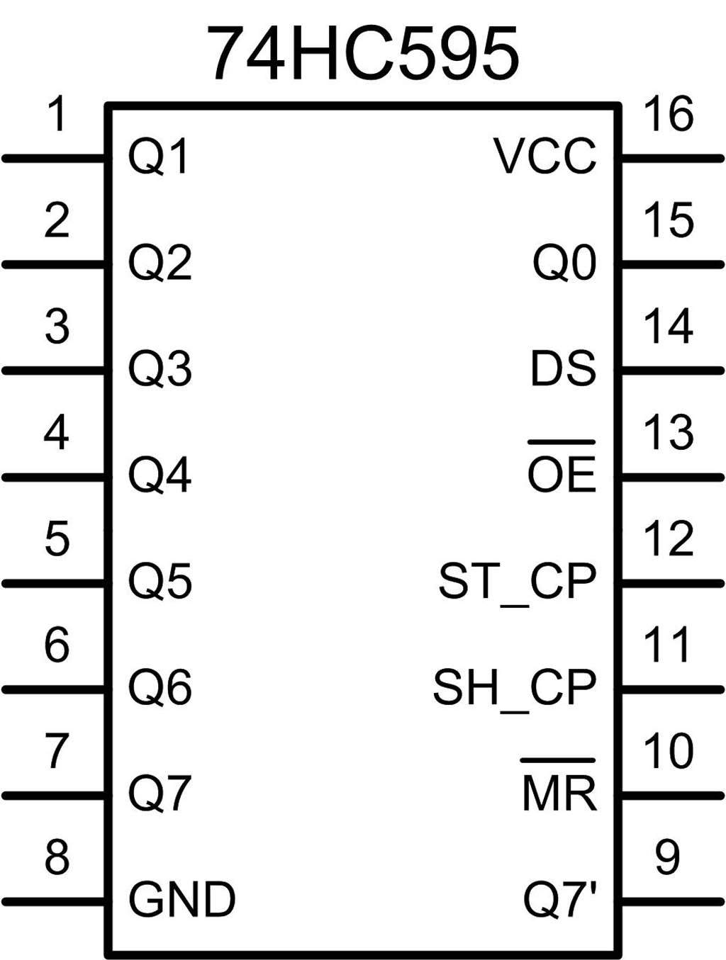
74HC595 Shift Register Pin-Out

Slide 9
Output Pins

Slide 10
GROUND Pin

Slide 11
Power Source (+5V)

Slide 12
Latch and Clock Pins

Slide 13
Data Pin

Slide 14
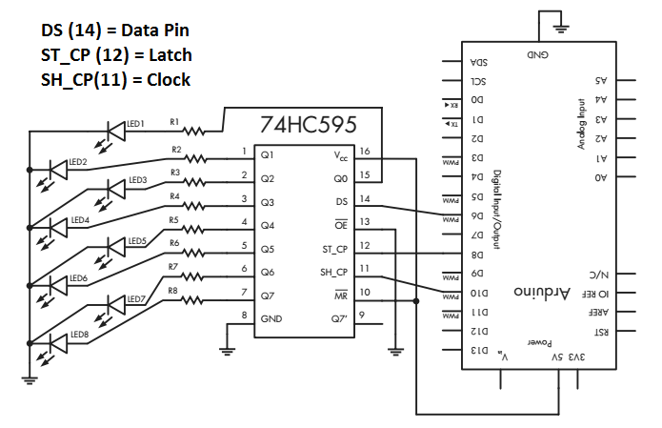

Slide 15
Code Needed to Shift Bits
shiftOut(dataPin, clockPin, bitOrder, value)
dataPin = Arduino pin that is connected to pin 14 on the shift register
clockPin = Arduino pin that is connected to pin 11 on the shift register
bitOrder = MSBFIRST (7 to 0) or LSBFIRST (0 to 7)
value = the value to shift out (as a decimal number or as a binary byte)

Slide 16
Example Code:
int data=6; int latch=8; int clock=10;
void setup( ) {
pinMode(data, OUTPUT);
pinMode(latch, OUTPUT);
pinMode(clock, OUTPUT);
}
void loop( ) {
digitalWrite(latch, LOW); //prepare for shift
shiftOut(data, clock, MSBFIRST, B10000110);
digitalWrite(latch, HIGH); //shift the bits
}

Slide 17
Shifting Registers
Using the shift register,
Make all 8 LEDs light up, then wait 1 second
Make the first 4 LEDs light up, wait 1 second
Make the last 4 LEDs light up, wait 1 second
Make every other LEDs light up, wait 1 second

