Slide 1
Warm-up
What is a duty cycle?
If an Arduino has a duty cycle of 50%, what is the average voltage?

Slide 2
Warm-up
What is a duty cycle?
Represents the amount of time (as a percentage) voltage is high per cycle
If an Arduino has a duty cycle of 50%, what is the average voltage?
2.5 V

Slide 3
Today…
RGB LEDs
Pin Diagram
Light Color Truth Table

Slide 4
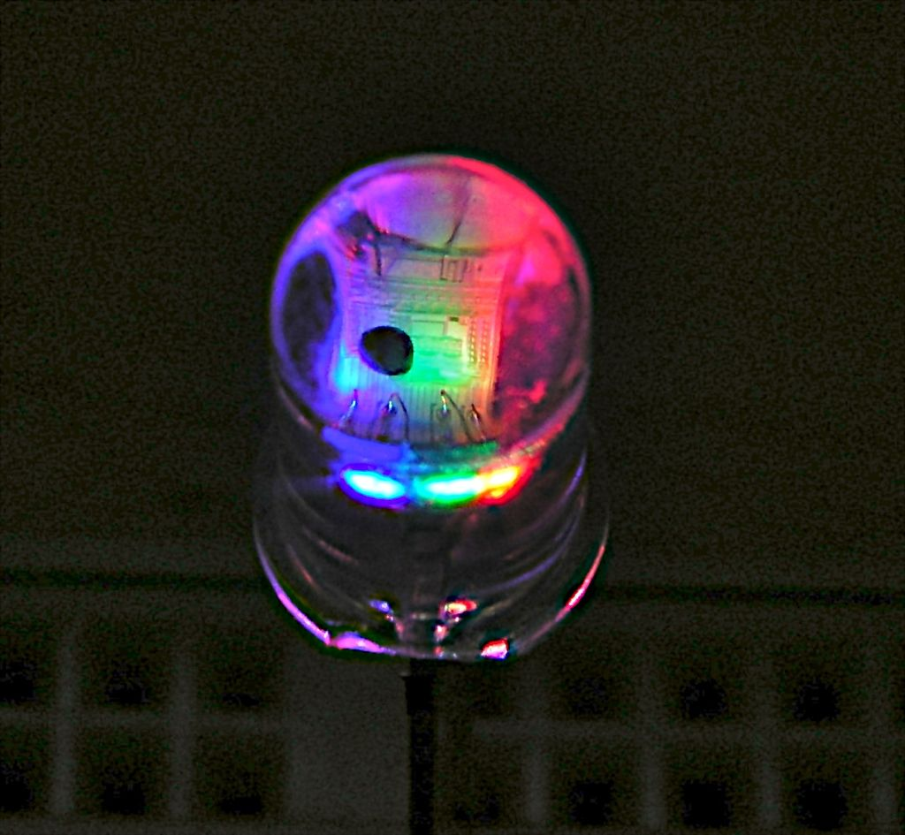
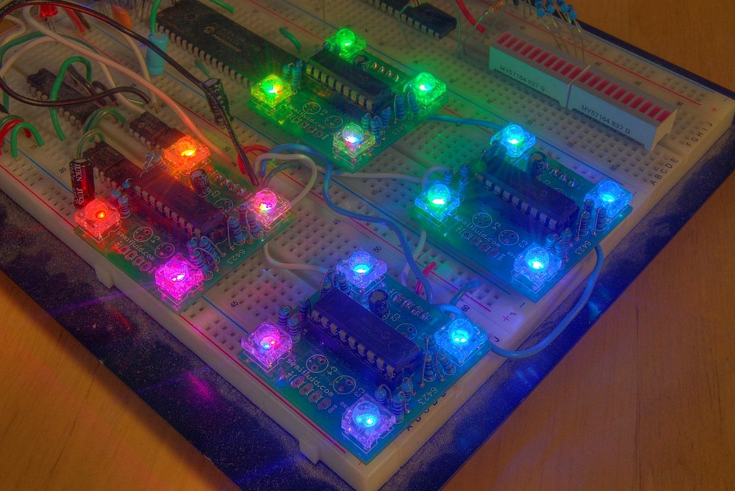
RGB – Red Green Blue
Three LEDs in one!!

Slide 5
Pin Diagram

Slide 6
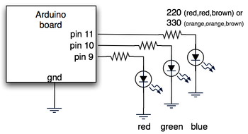
Circuit Design

Slide 7
RGB Worksheet
USE THE ARDUINO (not the Internet!!) to complete the RGB worksheet on the color truth table found on the class website
You may work in your group but each person is responsible for their own worksheet
Turn in the worksheet by the end of class (to the class website)
Then, use PWM to dim and brighten each color at different times. This way, you can use your RGB LED to generate millions of different colors.

Slide 8
Warm-up
How can you tell which pin is ground on an RGB LED?
What does RGB stand for?

Slide 9
Warm-up
How can you tell which pin is ground on an RGB LED?
It’s the longest one.
What does RGB stand for?
Red, Green, Blue

Slide 10
RGB Day 2
Use PWM to dim and brighten each pin at different times, causing the LED to cycle through each color in the spectrum.
Use analogWrite(led, random(256)) to generate a random color.

