Slide 1
Warm-up
Pick up an extra shift register and an extra 7-segment display per team.
If you destroyed your previous 7-segment display circuit, begin re-wiring it.

Slide 2
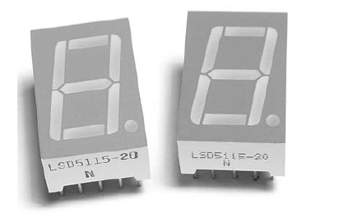
Double Digit Display
You will create a double digit display
You will ask for a user’s input from the
serial monitor and display it (from 0 to 99)
You already have the code for reading in multi-digit numbers, now you need the code to display it.

Slide 3
Separating the Digits
Once you read in the multi-digit number you need to separate the digits
You do this by dividing the number by 10 to get the first digit (remember that dividing does not return a fraction nor remainder) and then using mod by 10 to get the second digit

Slide 4
Mod
Mod is short for modulo and returns the remainder and not the quotient of a division problem
20%10 =
20%3 =
20%7 =

Slide 5
Mod
Mod is short for modulo and returns the remainder and not the quotient of a division problem
20%10 = 0
20%3 = 2
20%7 = 6

Slide 6
Example
User inputs 23
23/10 = 2
23%10= 3
Now you need to shift these out to the displays
digitalWrite(LATCH, LOW);
shiftOut(DATA, CLOCK, LSBFIRST, digits[right]); //ones
shiftOut(DATA, CLOCK, LSBFIRST, digits[left]); //tens
digitalWrite(LATCH, HIGH);
Notice how the data, clock, and latch pins are the same. Both of your 7-segment displays need to be physically connected so they display correctly.

Slide 7
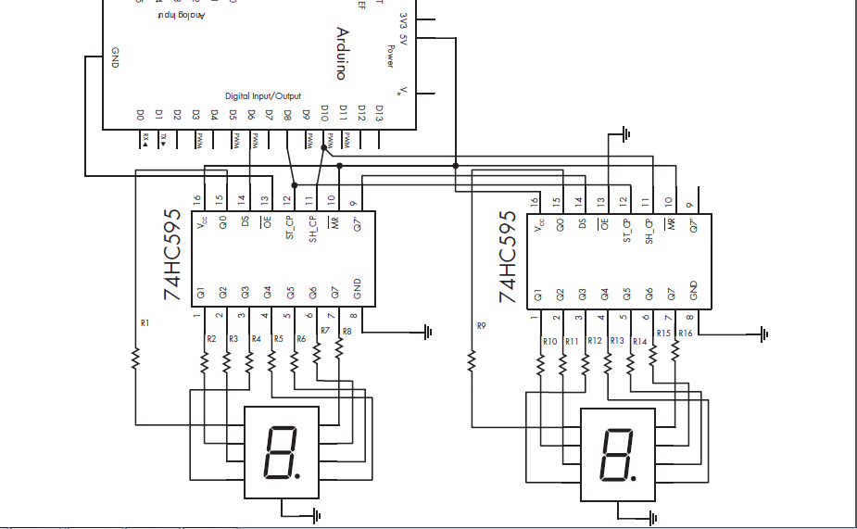

Slide 9
Functions
You should copy your “getAnswer” function from the previous lab
You should create a new function for displaying (this function should take the user’s input as a parameter)
Within this function you need to determine if the user entered a single or double digit number
If the user entered a single digit number (<10) display the number followed by a zero
If the user entered a double digit (>=10) you need to separate them using / and %
You should keep your decimal array from you previous lab as well and use the separated digits to access the array at that specified index

