Slide 1
Think about the following:
How many resistors did you need to wire your new circuit?

Slide 2
Think about the following:
How many resistors did you need to wire your new circuit?
16

Slide 3
Shifting Out Your Image
Create an array that holds each power of 2. This will be used to indicate which row you should be lighting up each time
int binary[ ] = {1, 2, 4, 8, 16, 32, 64, 128};

Slide 4
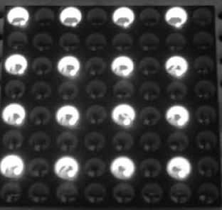
Checking Your Circuit
To make sure your circuit is wired properly place this code in the main loop
for (int i=0; i<8; i++) {
digitalWrite(latch, LOW);
shiftOut(data, clock, MSBFIRST, ~B10101010);
shiftOut(data, clock, MSBFIRST, B10101010);
digitalWrite(latch, HIGH);
delay(1); }

Slide 5
Shifting Out Your Image
Begin a loop that will run 8 times. Inside the loop, shift out each line of your image along with the proper row it should be shifted to.
for(int hold=0;hold<100;hold++){
for (int i=0; i<8; i++) {
digitalWrite(latch, LOW);
shiftOut(data, clock, MSBFIRST, smile[i]);
shiftOut(data, clock, MSBFIRST, ~binary[i]);
digitalWrite(latch, HIGH);
delay(1); }
}

Slide 6
LED Matrix Lab
Come up with 5 different images for your matrix
Have the matrix display each image, waiting 5 seconds before displaying the next one.
What will be graded:
Your working circuit
Your image designs
Your working code

