Slide 1
Warm-up
Unplug your seven segment displays (and only that) from your breadboard and pick up an LED Matrix from the front.
If you combined your circuits you should also take this time to separate them.

Slide 2
Color Zone Notices
Green – Good Standing
Yellow – Possible Failure
Red – Severe Possible Failure

Slide 3
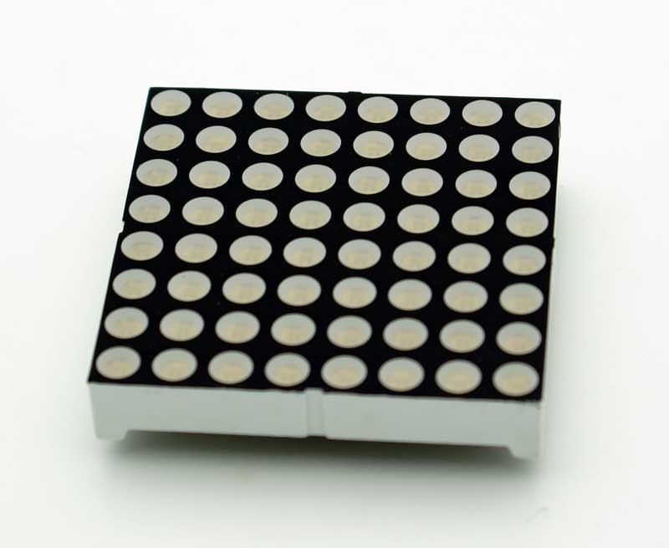
8x8 LED Matrix

Slide 4
8x8 LED Matrix
Consists of 8 rows and 8 columns of LEDs
64 total LEDs
Dual color – Red, Green, Yellow (Red+Green)
Uses:
Digital display
Animation screen
Pictures
Color graphics

Slide 5
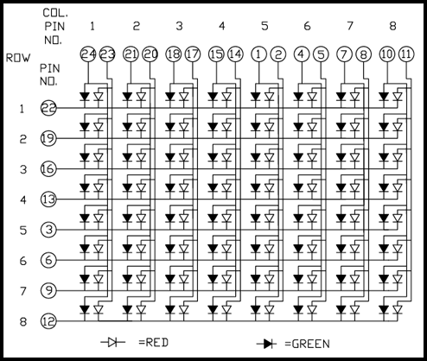
Schematic

Slide 6
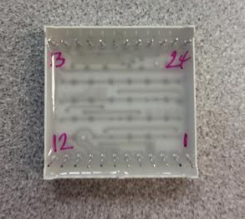
Pins are numbered clockwise from 1.

Slide 7
Wiring LED Matrix
You will need to assign one Shift Register as the column register and another as the row register.
Remember that “Row 1” is actually referring to pin Q0 on the shift register. “Row 8” is Q7 on your “Row Register”

Slide 8
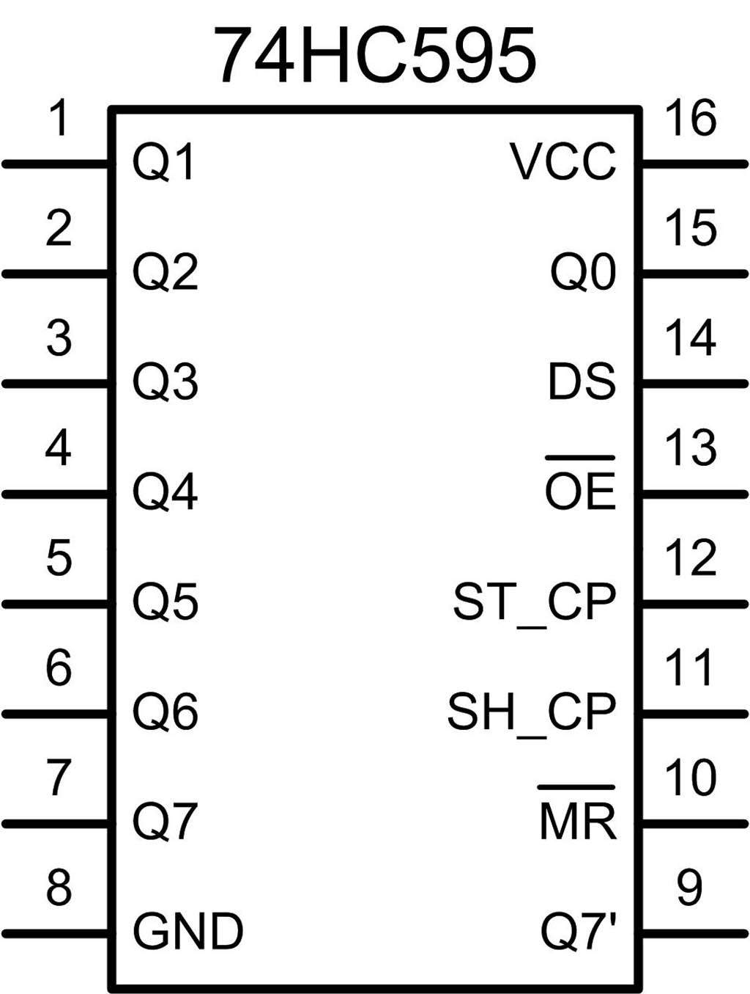
Wiring Reference

