Slide 1
Warm-Up
How are analog signals different from digital signals?
Why does the Arduino only have analog input pins, and no analog output pins?

Slide 2
Warm-Up
How are analog signals different from digital signals?
Analog – any value on an infinite spectrum
Digital – finite number of value possibilities (all others get rounded down or up
Why does the Arduino only have analog input pins, and no analog output pins?
The Arduino is a digital device, like all electronic devices. Analog can be converted to digital, but digital could never be translated back into analog (information is lost in translation that cannot be recovered)

Slide 3
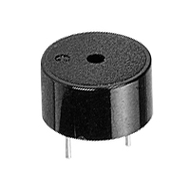
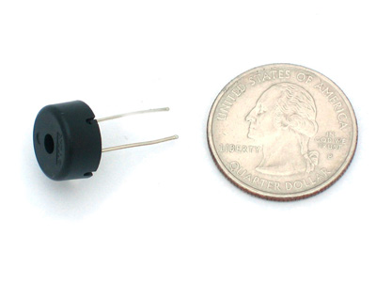
Piezoelectric Buzzers
Alternating current vibrates a thin plate inside the buzzer
Vibration of the plate causes a buzzing sound
Not polarized – can be connected in either direction
Dependent on alternating current frequency and voltage

Slide 4
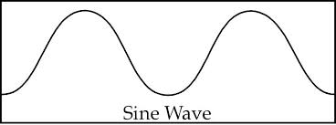
Alternating Current
Similar to PWM
Current alternates high and low, like a sine or step wave

Slide 5
Frequency Affects Piezo Tone
Low frequency = deep tone
High frequency = high pitch

Slide 6
Voltage Affects Piezo Volume
Low voltage = soft
High voltage = loud

Slide 7
Our Piezo Buzzers
Rated for 3-12V
This means that at 5V, we will be at the lower end of the volume spectrum
They’ll be kind of quiet
How to make them louder?
Transistor
9V or 12V battery/power source
May explore this later

Slide 8
Schematic
1K Ohm
Arduino ~ pin
Buzzer
GND

Slide 9
Base Code and Assignments
Be sure you declare your buzzer as an output and that you have it connected to a PWM pin.
Use digitalWrite() to turn the buzzer on and off for Task 1.
Use analogWrite() to vary the loudness of the buzzer for Task 2.
Task 1: Use your buzzer to transmit a secret word in Morse code. Decide on you word, and look up the Morse code translation on the Internet. (A WORD, NOT A SENTENCE!)
Task 2: Make the buzzer sound on and off (like a siren). The sound should lower until it is inaudible and then get louder.

