Slide 1
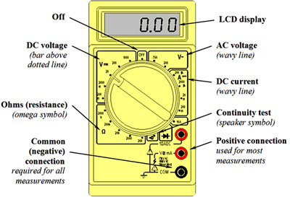

Slide 2
Buzzing Temp Lab
Combine your temperature and buzzing circuits so that the buzzer gets louder the hotter the temperature. (Note: you don’t actually need to physically combine the circuits)
60 degrees should be completely silent and 90+ should be the loudest possible. (255)

