Slide 1
Warm-up
How many different kinds of programming loops are there, and what are they?
Why can using variables to name pins be helpful?
What are the 4 pieces of every programming loop?

Slide 2
Warm-up
How many different kinds of programming loops are there, and what are they?
2 – for loop and a while loop
Why can using variables to name pins be helpful?
Variable names can help you keep track of what is connected to each pin, especially when you have 5 different things (LEDs, buzzers, switches) plugged in
What are the 4 pieces of every programming loop?
Initiation, Condition, Update, Statements

Slide 3
Pink Slips
If you received a pink slip you have a failing grade for this progress report period.
You need to return the slip to me on Monday of next week with a parent signature. THIS IS FOR A GRADE
If you did not receive a pink slip your grade for this assignment is automatically 100

Slide 4
Today…
Pulse Width Modulation (PWM)
Duty Cycles
Project #3

Slide 5
What is PWM?
Optical illusion
Idea that you can pulse something off and on really fast (too fast for your brain to notice), to make it look like it’s slowly dimming or brightening
LEDs (Christmas lights)
Motors
Buzzers
Speakers

Slide 6
https://www.youtube.com/watch?v=YmPziPfaByw

Slide 7
High Frequency
Key → Turn on and off REALLY FAST
500 cycles each second
Brain can only register flickering at about 50 cycles per second

Slide 8
Duty Cycles
The dimming illusion comes from how often the LED stays on versus how much time it stays off
Duty Cycle
Represented as a percentage
100% duty cycle → LED stays on 100% of the time
50% duty cycle → LED stays on half of the time
Equal time on, equal time off
25% duty cycle → LED stays on ¼ of the time
Stays off three times as much as it stays on

Slide 9
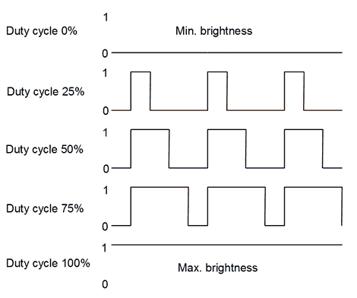

Slide 10
Arduino PWM Pins
Not all digital pins are capable of PWM
Only the ones marked with a tilde (~)
3, 5, 6, 9, 10, 11
analogWrite(x, y)
x → pin you want to create PWM with
y → a value for how much voltage should be applied to the pin
Range from 0 to 255
0→0V
255→ 5V (full power)

Slide 11
int d = 5; //cycle lasts 5 milliseconds
int led=3;
void setup( ) {
pinMode(led, OUTPUT);
}
void loop( ) {
for (int a=0; a<256; a++) { //brighten
analogWrite(led,a);
delay(d);
}
for (int b=255; b>=0; b--) { //dim
analogWrite(led,b);
delay(d);
}
delay(200); //wait 200ms between cycles
}

Slide 12
Project #3
Put 1 LED onto PWM, then
Put all 5 LEDs onto PWM at the same time, then
Put all 5 LEDs onto PWM sequentially.
Create your own dimming pattern

