Slide 1
Warm-Up
What does the delay() function do?
What goes inside the void loop () section of your code?

Slide 2
Warm-Up
What does the delay() function do?
Makes the program wait a specified number of miliseconds
What goes inside the void loop () section of your code?
The actual code you want the Arduino to execute and repeat.

Slide 3
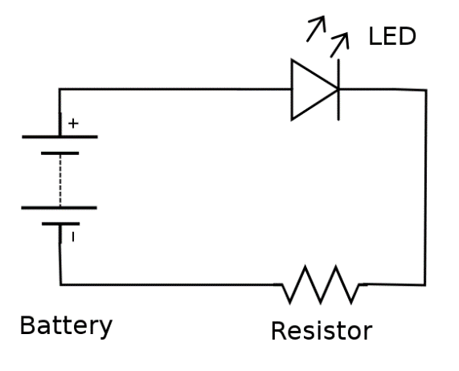
Circuit Diagram

Slide 4
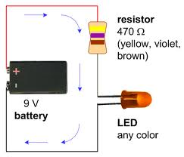
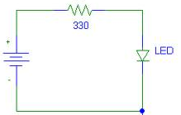
Simple LED Circuit

Slide 5
Diodes and LED’s
Diodes restrict current direction
Only let it flow in one direction
Commonly used in safety circuits, charging circuits, or in very complex circuits
LEDs (Light Emitting Diodes)
Diodes that emit light when current passes through them

Slide 6
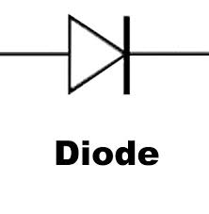
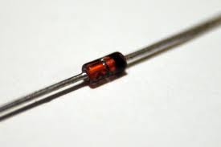
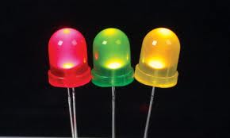
Diodes and LEDs

Slide 7
Anodes and Cathodes
Diodes and LEDs are direction-dependent
There is a RIGHT way and a WRONG way to install them
Electrons ENTER at the ANODE
Electrons LEAVE at the CATHODE

Slide 8
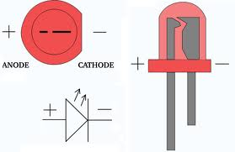
Anode and Cathode - LEDs

Slide 9
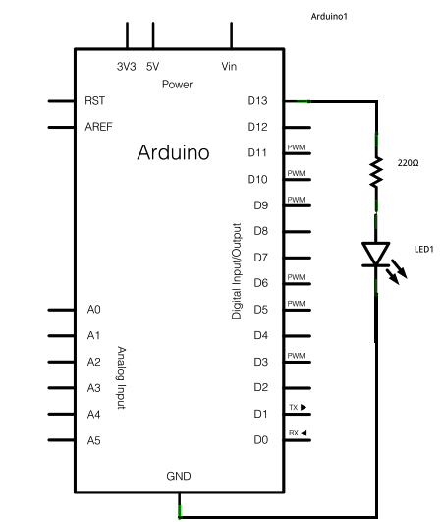
Project #0

Slide 10
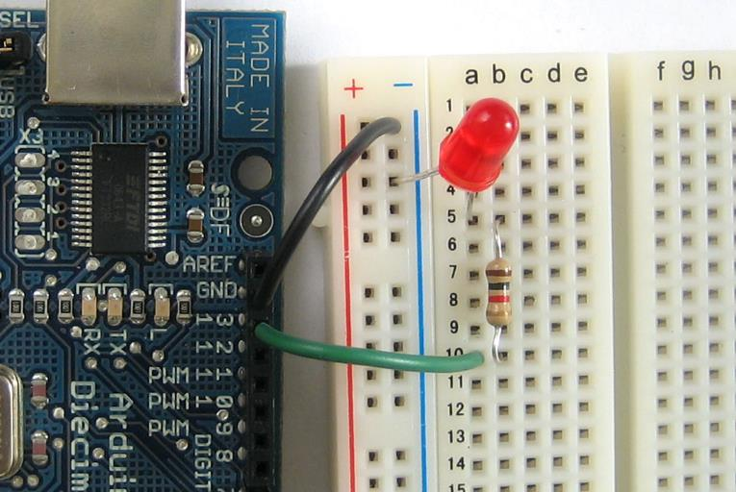
Project #0 (Use a 560Ω Resistor)

Slide 11
Project #1
Pick 4 more LED’s (they can be any color)
Create 4 more LED circuits with resistors, going to any digital pins you want
Add these pins to void setup()
Perform the following tasks:
Make all 5 LEDs blink together
Make the next LED turn on as the previous turns off
Make the LEDs do the wave
Create your own custom pattern
Document your codes in your Google Doc notebook

