Slide 1
Warm-Up
What are breadboard power rails?
Are rows connected across the middle divide on a breadboard?
Check your grades. If you have a zero you are missing that grade. Some of you walked out with your quiz on Friday!
Download Arduino software if you don’t already have it.

Slide 2
Warm-Up
What are breadboard power rails?
Vertical rows meant for distributing voltage across the entire breadboard for easy access at any point
Are rows connected across the middle divide on a breadboard?
No. Nothing is connected across the middle divide. Wire must be used to bridge rows on either side of a breadboard.

Slide 3
First Code – “Blink( )”
Equivalent to “Hello world” for the Arduino
Open up a new sketch.
We’re going to use the built-in LED on the Arduino board.
It is internally connected to pin 13.
Notes:
ADD PICTURE OF ARDUINO UNO LED LOCATION AND PIN 13 LOCATION

Slide 4
Setup
First step of any Arduino code is to establish whether your pins are input or output
Input → Information is going INTO the Arduino from the outside world (ex, sensors, buttons)
Output ← Information is going OUT from the Arduino to trigger a response in the hardware (ex, turning on a buzzer or a motor)
Is pin 13 INPUT or OUTPUT?

Slide 5
Setup
Add the following code to your sketch:
void setup( ) {
pinMode(13,OUTPUT);
}
This lets the Arduino know that pin 13 is output

Slide 6
The Action
We want to blink the built-in LED
Algorithm:
Turn on the LED
Wait 1 second
Turn off the LED
Wait 1 second
Repeat
digitalWrite( ) – used to turn a pin HIGH or LOW (on or off)
delay( ) – used to make the Arduino wait

Slide 7
The Action
The Algorithm
The Code
Turn on the LED
Wait 1 second
Turn off the LED
Wait 1 second
Repeat
void loop( ) {
digitalWrite(13, HIGH);
delay(1000);
digitalWrite(13, LOW);
delay(1000);
}

Slide 8
Complete “Blink” Code
//Turns on an LED on for one second, then off for one second, repeatedly.
// the setup routine runs once when you press reset:
void setup() {
// initialize the digital pin as an output.
pinMode(13, OUTPUT);
}
// the loop routine runs over and over again forever:
void loop() {
digitalWrite(13, HIGH); // turn the LED on
delay(1000); // wait for a second
digitalWrite(13, LOW); // turn the LED off
delay(1000); // wait for a second
}

Slide 9
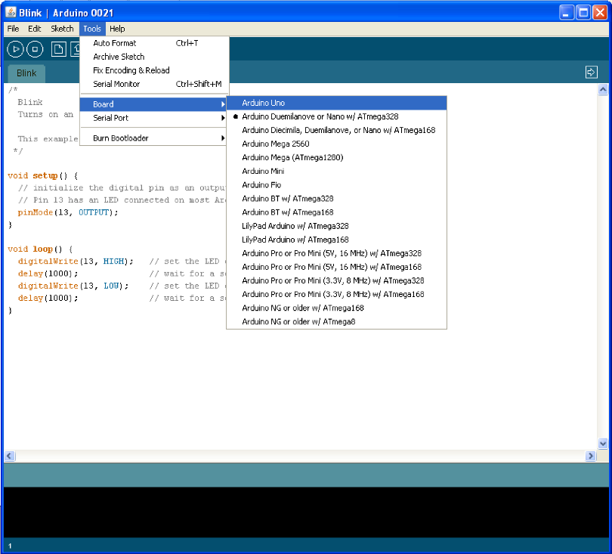
Connect and Initialize the Arduino
Make sure the Arduino is plugged into the computer via the USB drive
Make sure the Arduino UNO is selected as the board type

Slide 10
Verify and Upload the Code
Checkmark: Verify
Arrow: Verify AND Upload

Slide 11
Your Turn!
Adjust the blinking frequency by changing the delay time
3 seconds on and off
500 milliseconds on and off
2 seconds on, 1 second off

Slide 12
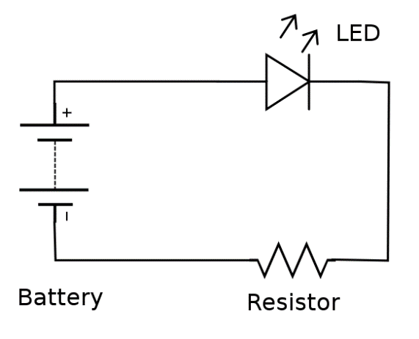
Circuit Diagram

Slide 13
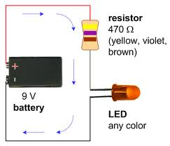
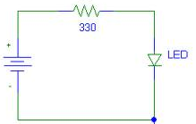
Simple LED Circuit

Slide 14
Diodes and LED’s
Diodes restrict current direction
Only let it flow in one direction
Commonly used in safety circuits, charging circuits, or in very complex circuits
LEDs (Light Emitting Diodes)
Diodes that emit light when current passes through them

Slide 15
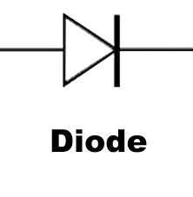
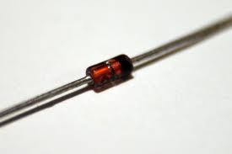
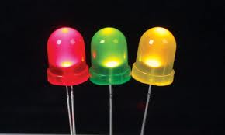
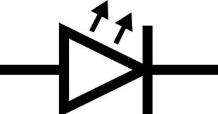
Diodes and LEDs

Slide 16
Anodes and Cathodes
Diodes and LEDs are direction-dependent
There is a RIGHT way and a WRONG way to install them
Electrons ENTER at the ANODE
Electrons LEAVE at the CATHODE

Slide 17
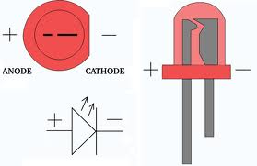
Anode and Cathode - LEDs

Slide 18
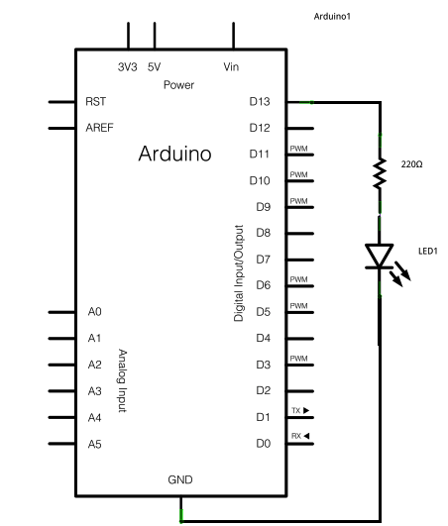
Project #0

Slide 19
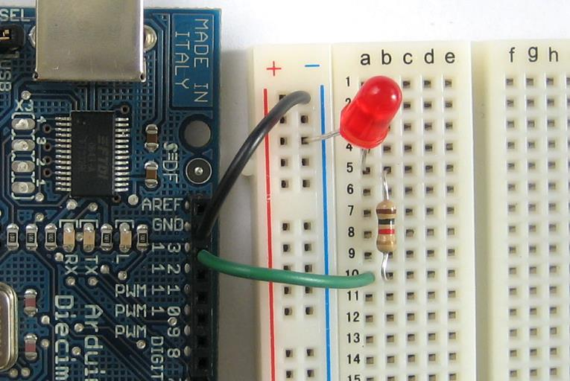
Project #0

