Slide 1
Meet Your New Partner

Slide 2
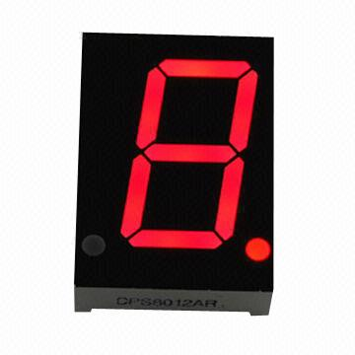
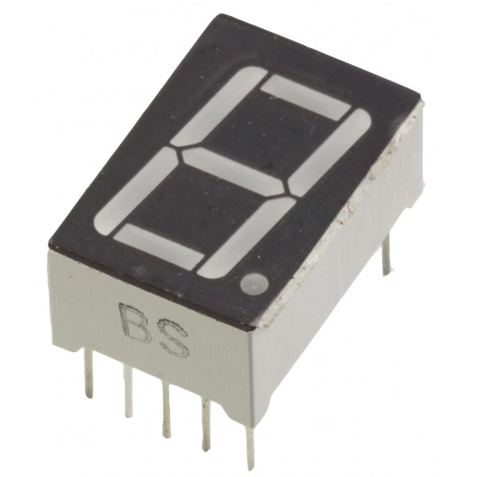
7-Segment LED
Used to display characters
Light up different LED segments to create the characters

Slide 3
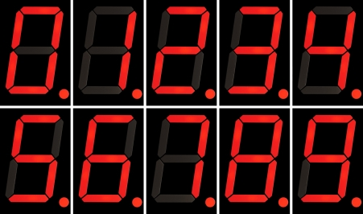
Displaying Numbers 0-9

Slide 4
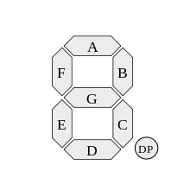
Naming the Segments
Each segment is named using the letters A-F
The decimal point is shorted to DP on design schematics

Slide 5
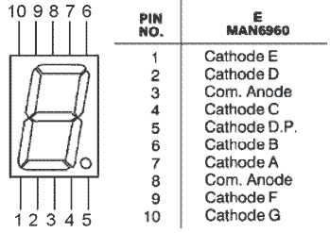
Pin Diagram

Slide 6
Common Anode
Our 7-segment LEDs are common anode
Share the same power source, NOT the same ground
To turn ON an LED, you need to shift a 0
To turn OFF an LED, you need to shift a 1

Slide 7
Circuit Diagram (kind of)
Pin 1 → Q4 on shift register
Pin 2 → Q3 on shift register
Pin 3 → 5V on Arduino
Pin 4 → Q2 on shift register
Pin 5 → Q7 on shift register
Pin 6 → Q1 on shift register
Pin 7 → Q0 on shift register
Pin 8 → 5V on Arduino
Pin 9 → Q5 on shift register
Pin 10 → Q6 on shift register

Slide 8
7SD Countdown
Use your 7-segment display to count down from 9 to 0
Use your 7-segment display to display a randomly generated number
Bonus: Make the 7-segment display display your birthday.

